Slide 1
Chapter 15

Slide 2
Objectives

Slide 3
The IDisplayable interface

Slide 4
A Product class that implements the IDisplayable interface

Slide 5
Code that uses the IDisplayable interface

Slide 6
A comparison of interfaces and abstract classes

Slide 7
Commonly used .NET interfaces

Slide 8
Common .NET interfaces for collections

Slide 9
Common .NET interfaces for collections (cont.)

Slide 10
The syntax for creating an interface

Slide 11
An interface that defines one method

Slide 12
The syntax for creating an interface that inherits other interfaces

Slide 13
The syntax for implementing an interface

Slide 14
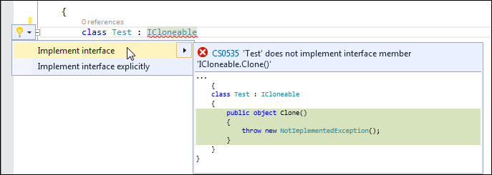
The Quick Actions menu for an interface name

Slide 15
The code that’s generated when you implement the interface

Slide 16
The code for the cloneable Product class

Slide 17
The code for the cloneable Product class (cont.)

Slide 18
Code that creates and clones a Product object

Slide 19
A CreateList method that uses an interface as a parameter

Slide 20
Code that uses these methods

Slide 21
A CustomList<> class that uses generics

Slide 22
A CustomList<> class that uses generics (cont.)

Slide 23
Code that uses the CustomList<> class

Slide 24
Output that results from the Test 1 and Test 2 code

Slide 25
A common generic .NET interface

Slide 26
Common .NET interfaces for generic collections

Slide 27
Common .NET interfaces for generic collections (cont.)

Slide 28
A class that implements the IComparable<> interface

Slide 29
Code that uses the class

Slide 30
Values that can be returned by the CompareTo method

Slide 31
A class that uses constraints

Slide 32
A class that uses constraints (cont.)

Slide 33
Keywords that can be used to define constraints

Slide 34
A class that implements IEnumerable<>

Slide 35
Code that uses the class

Slide 36
An interface named IGenericPersistable<> that uses generics

Slide 37
A class that implements IGenericPersistable<>

Slide 38
A class that implements IGenericPersistable<>

Slide 39
Exercise 15-1 Implement the ICloneable interface

Slide 40
Project 3-5 Maintain student scores (Student class)

Slide 41
Project 3-6 Translate English to Pig Latin or Pig Greek

